Slide 1
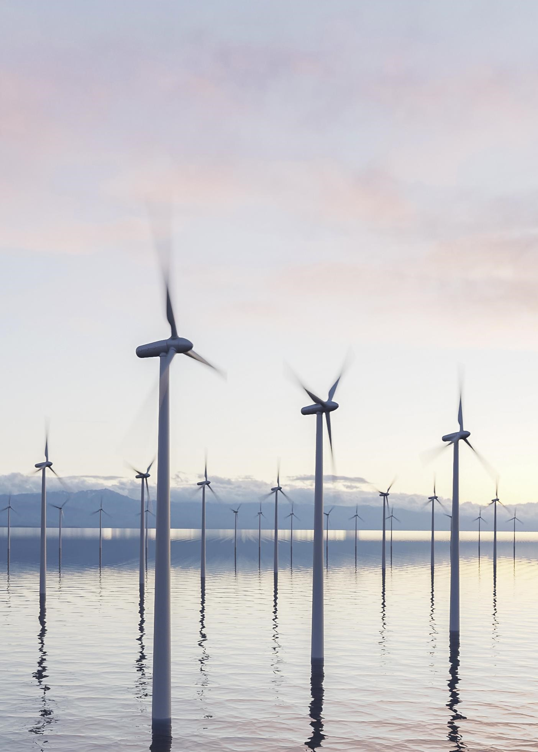
Title slide + image
LiDAR Enhanced Closed-Loop Active Wake Mixing Control
Zekai (David) Chen

Slide 2
Agenda
Create/edit a Hyperlink TO A SLIDE
1
Go to the tab ‘Insert’ and click on the button ‘Shapes’. Choose the shape ‘Rectangle’ and drag the mouse over the slide to create a shape.
Shapes
2
Drag the shape over the menu button and scale the shape as large as the button. Click with the right mouse button on the shape and choose ‘Edit shape’.
Size and position…
Edit shape…
3
Click on the paint bucket icon, click on ‘Shape Fill’ and drag the ‘Transparency’ slider to 100%. Now the shape is completely transparent.
01
02
03
04
05
Background & Introduction
Research Question
System Design
Experiment Validation
Conclusion & Future Work
Transparency
100%
4
Click on the transparent shape and use the shortcut Ctrl + K to add a hyperlink. At the left side of the window, click on ‘Place in this document’ and select the preferred slide in the list. Then click on ‘OK’.
5
Copy the transparent shape and repeat step 4. Do this for all menu buttons.
Want to know more? Go to the tab 'SLIDEBUILDER’ and click on the button ‘Inspiration'
Inspiration

Slide 3
Chapter | dark mode
01
Background & Introduction

Slide 4
Notes:
Attention catcher --- news

Slide 5
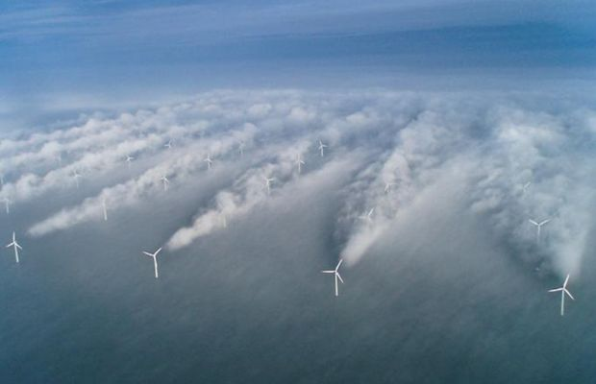
Wake Effect
Near-wake region:
Reduced wind speed
Increased turbulence intensity
Less power production
Increased structural loads
Notes:
The wake result in reduced wind speed and increased turbulence intensity --> power loss and increased structural load

Slide 6
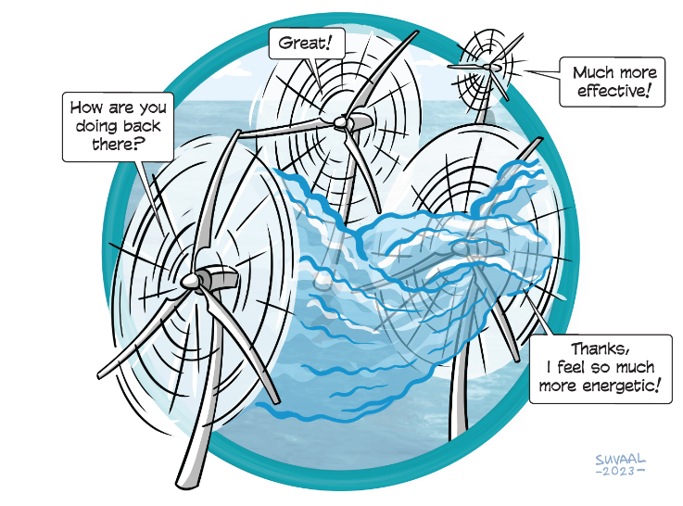
Wind Farm Flow Control (WFFC)
Axial Induction Control
Wake Steering
Wake Mixing

Slide 7
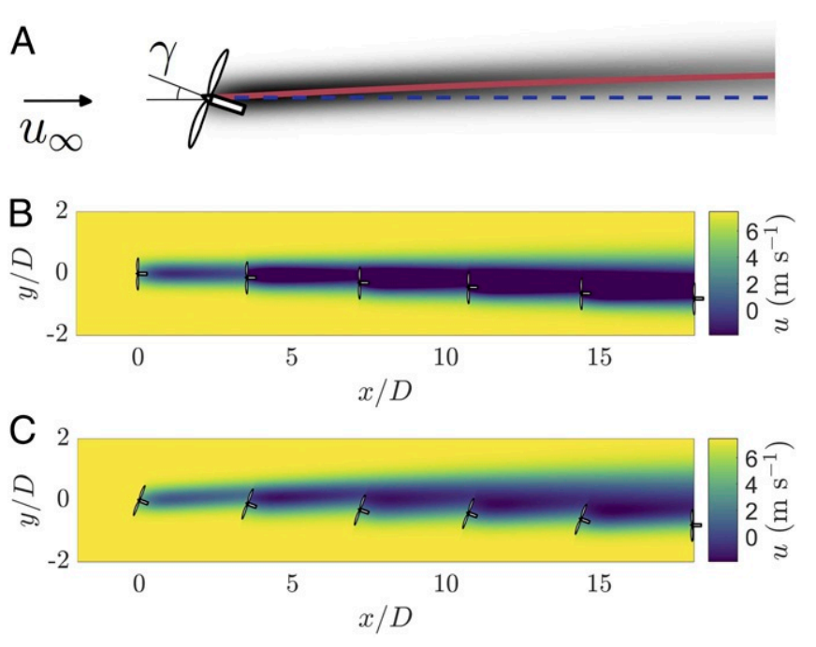
Wake Steering
Redirect the wake
Decrease overlap with the rotor
Higher speed and lower TI
Howland, Michael F., Sanjiva K. Lele, and John O. Dabiri. "Wind farm power optimization through wake steering." Proceedings of the National Academy of Sciences 116.29 (2019): 14495-14500.
Notes:
Redirect the wake --- decrease overlap with the rotor –- higher speed less TI

Slide 8
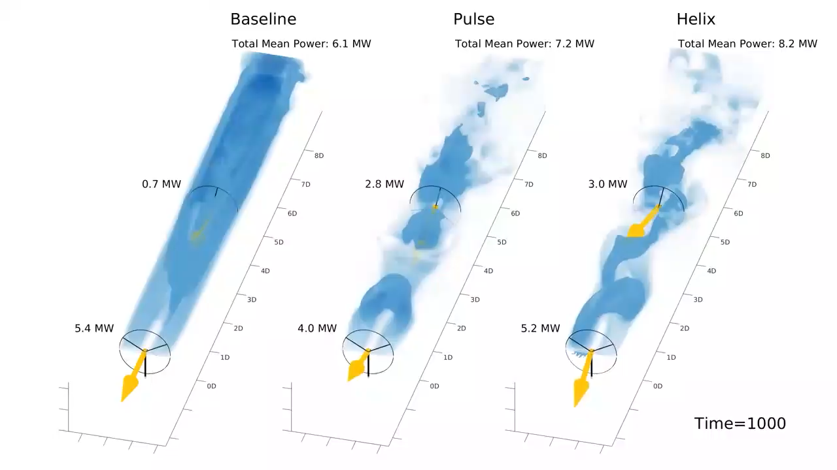
Wake Mixing
Facilitate mixing of free-ambient air and wake for wake recovery
https://www.youtube.com/watch?v=17tM3d1KKBw&t=55s

Slide 9
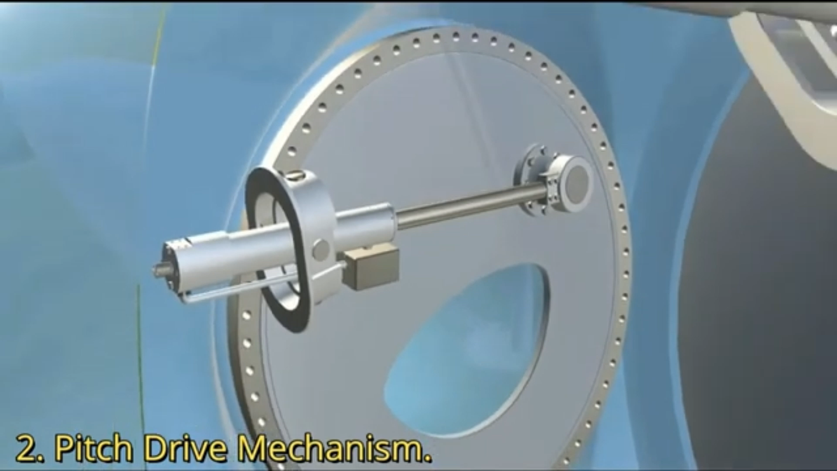
The Helix Approach
How to generate Helix?
Individual Pitch Control
https://www.youtube.com/watch?v=LDRHZ5ry-Ts

Slide 10
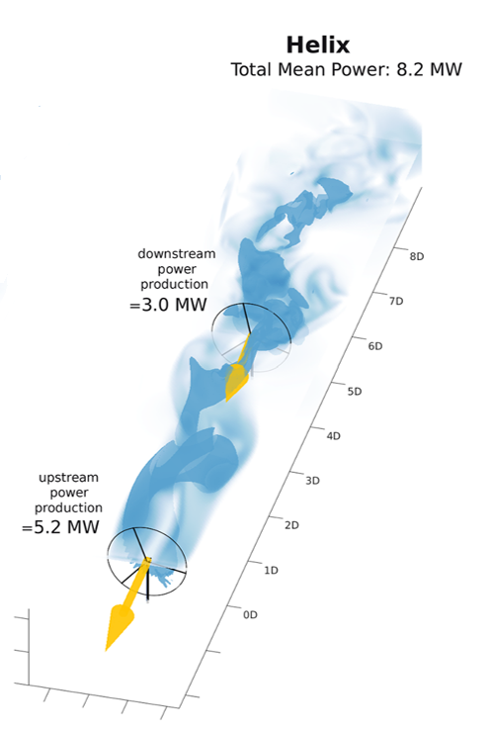
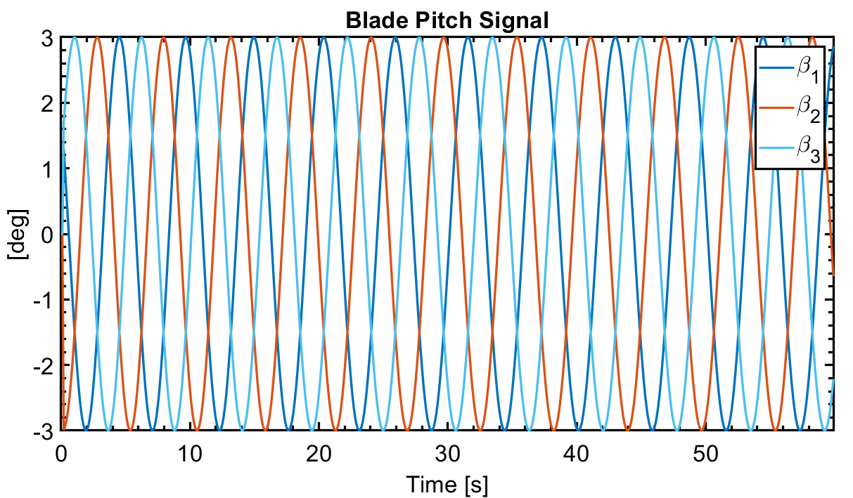
The Helix Approach (IPC)
Notes:
Can we simplify this rotating thing? In other words, can we see the signal in a different reference frame instead of individual blade

Slide 11
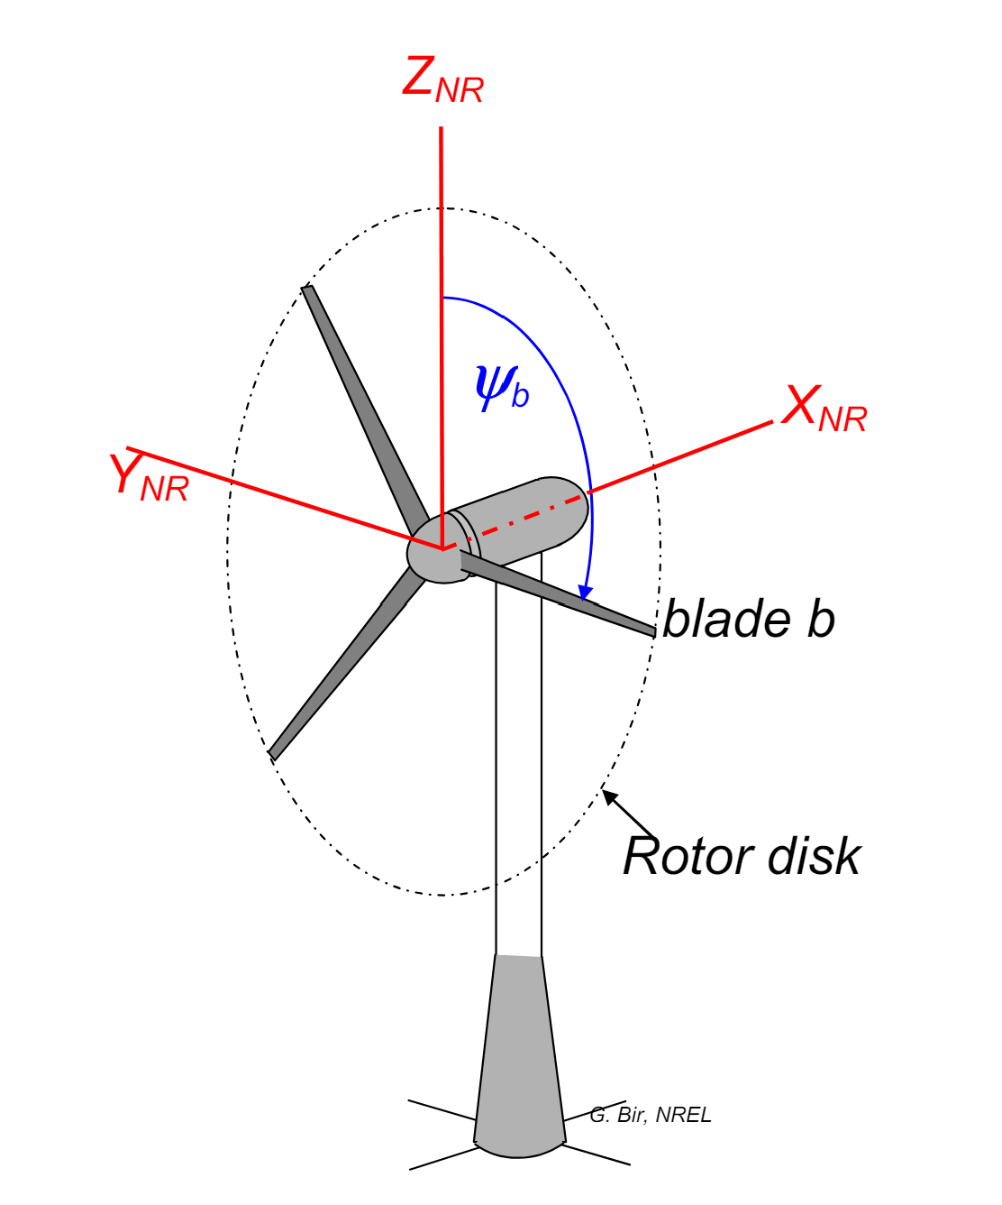
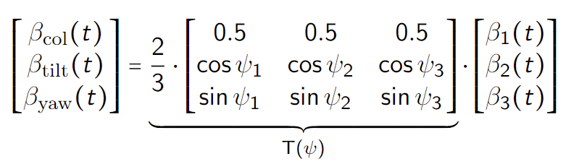
The Helix Approach (MBC)
Rotating Frame (Blade) → Fixed Frame (Rotor Disc)
Bir, Gunjit. "Multi-blade coordinate transformation and its application to wind turbine analysis." 46th AIAA aerospace sciences meeting and exhibit. 2008.
Notes:
MBC transform map the signals from rotating frame to the non-rotating one.
In this fixed frame, the individual pitch commands can be computed as decoupled collective, tilt, and yaw pitch commands respectively, allowing simple SISO control loops instead of MIMO

Slide 12
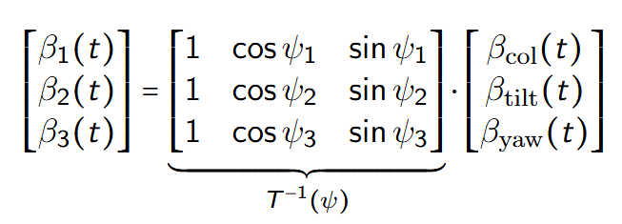
The Helix Approach (inv MBC)
Fixed Frame (Rotor Disc) → Rotating Frame (Blade)
Bir, Gunjit. "Multi-blade coordinate transformation and its application to wind turbine analysis." 46th AIAA aerospace sciences meeting and exhibit. 2008.
Notes:
MBC transform map the signals from rotating frame to the non-rotating one.
In this fixed frame, the individual pitch commands can be computed as decoupled collective, tilt, and yaw pitch commands respectively, allowing simple SISO control loops instead of MIMO

Slide 13
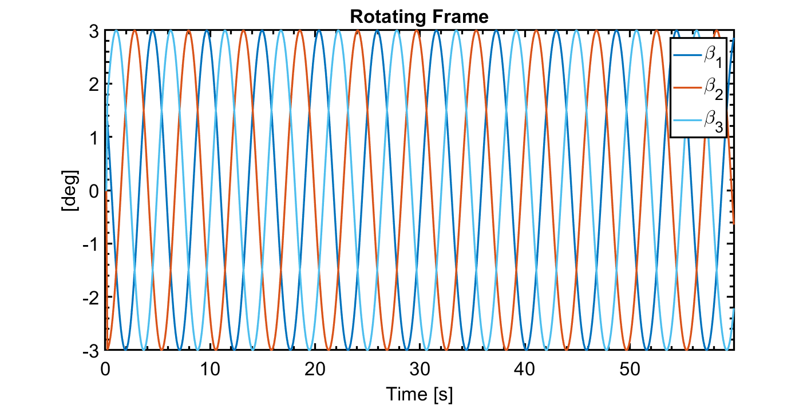
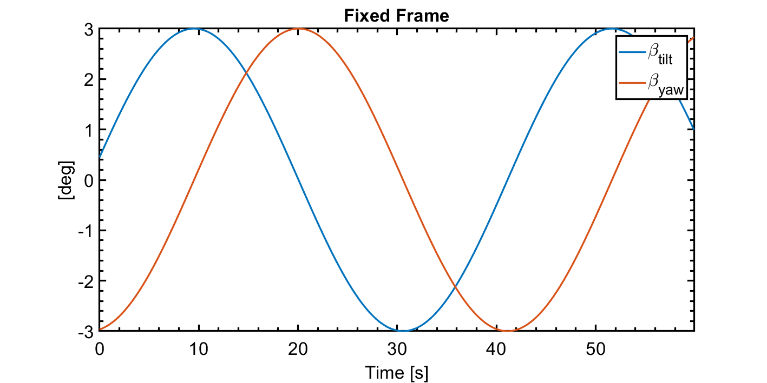
The Helix Approach (MBC)

Slide 14
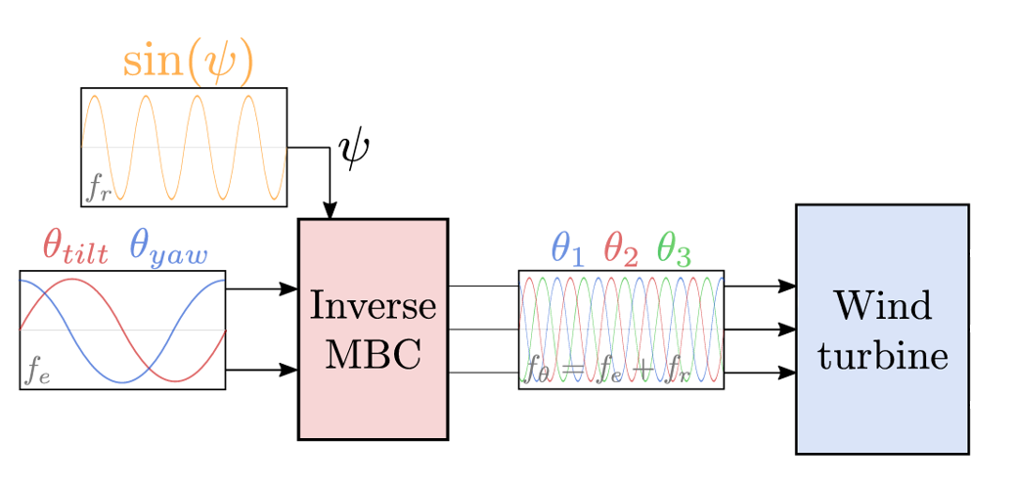
The Helix Approach
Frederik, Joeri A., et al. "The helix approach: Using dynamic individual pitch control to enhance wake mixing in wind farms." Wind Energy 23.8 (2020): 1739-1751.

Slide 15
The Helix Approach
Amplitude
Frequency
Phase difference
Frederik, Joeri A., et al. "The helix approach: Using dynamic individual pitch control to enhance wake mixing in wind farms." Wind Energy 23.8 (2020): 1739-1751.

Slide 16
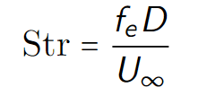
The Helix Approach
Amplitude
< 6 deg
Frequency
Phase difference
90° CCW
270 ° CW
Frederik, Joeri A., et al. "The helix approach: Using dynamic individual pitch control to enhance wake mixing in wind farms." Wind Energy 23.8 (2020): 1739-1751.

Slide 17
The Helix Approach
Open-loop Implementation
Frederik, Joeri A., et al. "The helix approach: Using dynamic individual pitch control to enhance wake mixing in wind farms." Wind Energy 23.8 (2020): 1739-1751.

Slide 18
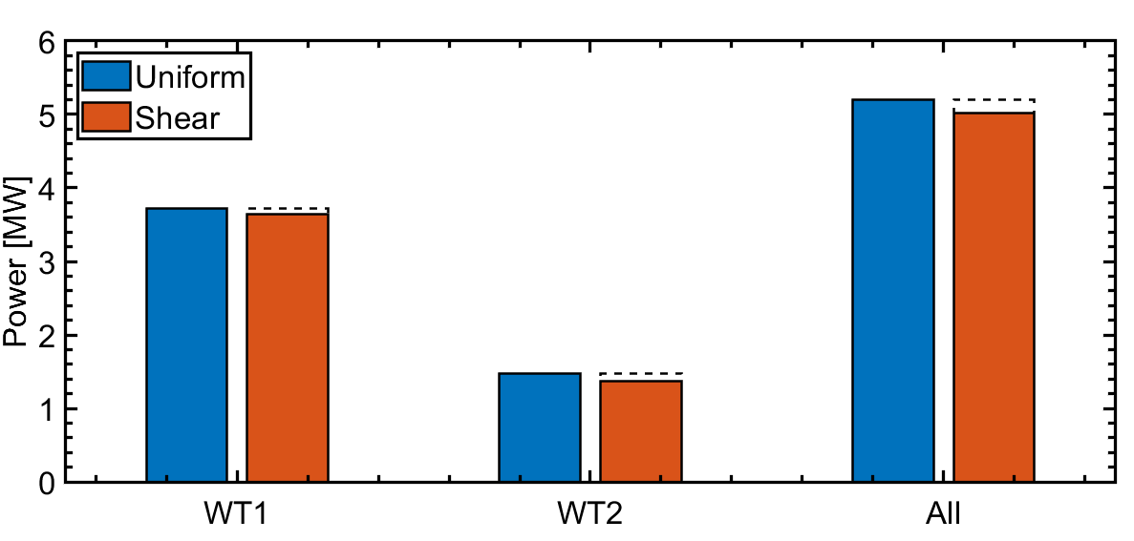
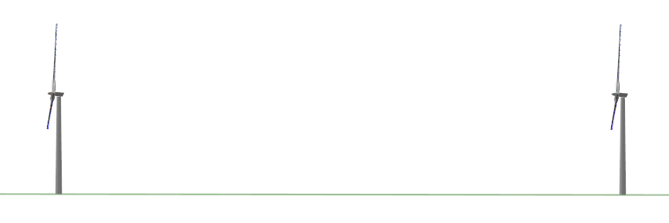
The Helix Approach
Closed-loop Control !!!
Open-loop Implementation
Turbine: NREL5MW
WT2 placement: 4D (502m)
Shear exp: 0.2
Madsen, Peter Hauge, and D. J. R. N. L. Risø. "Introduction to the IEC 61400-1 standard." Risø National Laboratory, Technical University of Denmark (2008).
Notes:
For example, when shear is added.

Slide 19
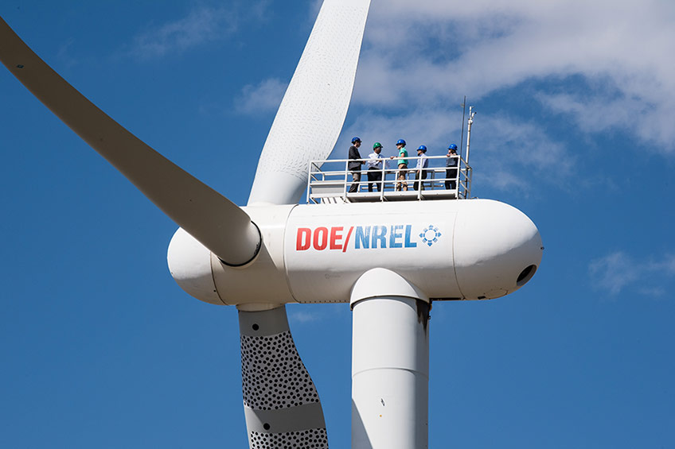
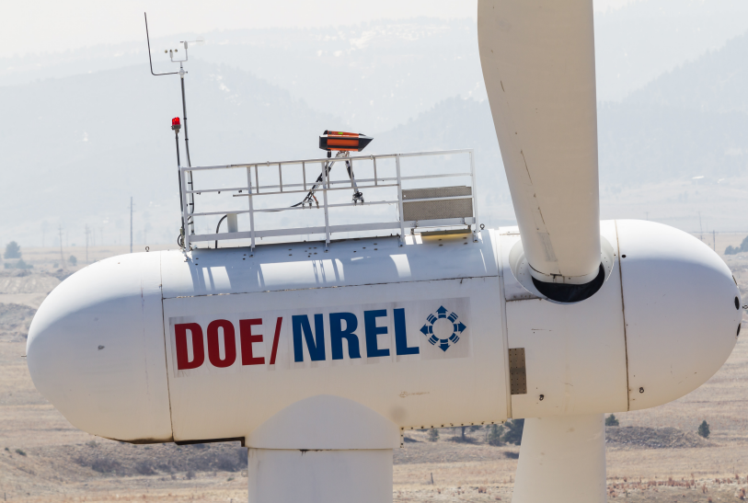
Feedback Measurement

Slide 20
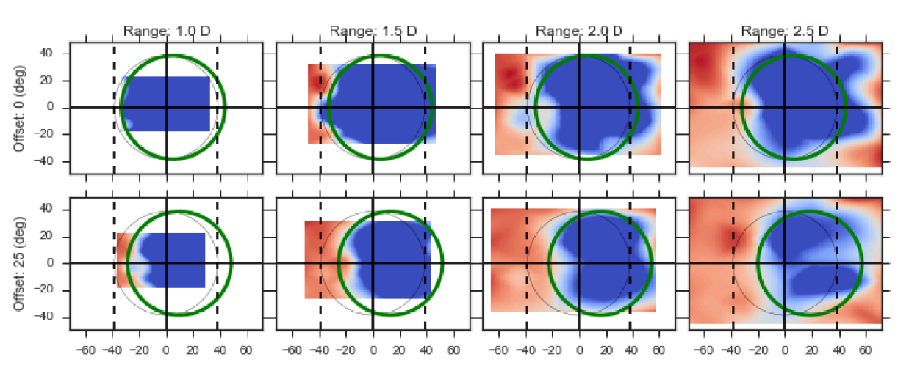
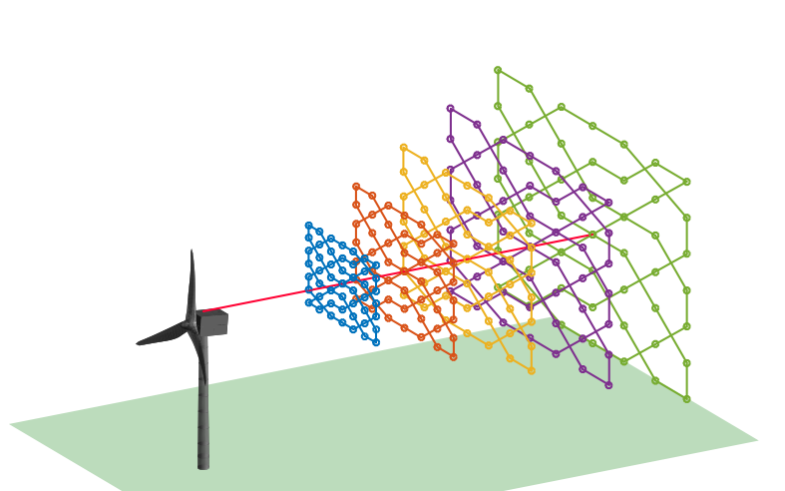
LiDAR in WFFC

Slide 21
Chapter | colour mode
02
Research Question

Slide 22
Quote
How to integrate LiDAR and the Helix approach for closed-loop wake mixing control for wind farms?

Slide 23
Afsluiter
Thanks
Zekai (David) Chen

Slide 24
Wake Effect
Near-wake region:
Reduced wind speed
Increased turbulence intensity
Less power production
Increased structural loads
Notes:
The wake result in reduced wind speed and increased turbulence intensity --> power loss and increased structural load

